Slide 1
Understanding GB Power Prices and Renewable Generation Methods
Power Price Drivers
Commodity Prices Influence Power Prices: Gas and coal price are the main driver
Seasonality: Power prices exhibit a seasonal pattern, driven by higher heating demands in winter months
Energy Technology Analysis
Renewable vs. Non-Renewable Generation: the generation gap is decreasing
Renewable Generation: Offshore and onshore wind dominate total generation and biomass shows highest load factor
Zach Wu
2024/07/14
Predicting Power Price for 2020
Linear Regression Model: outperforms other models, with gas price being the top feature
Predicted Price for 2020: closely follows the gas price, impacted by significant events

Slide 2
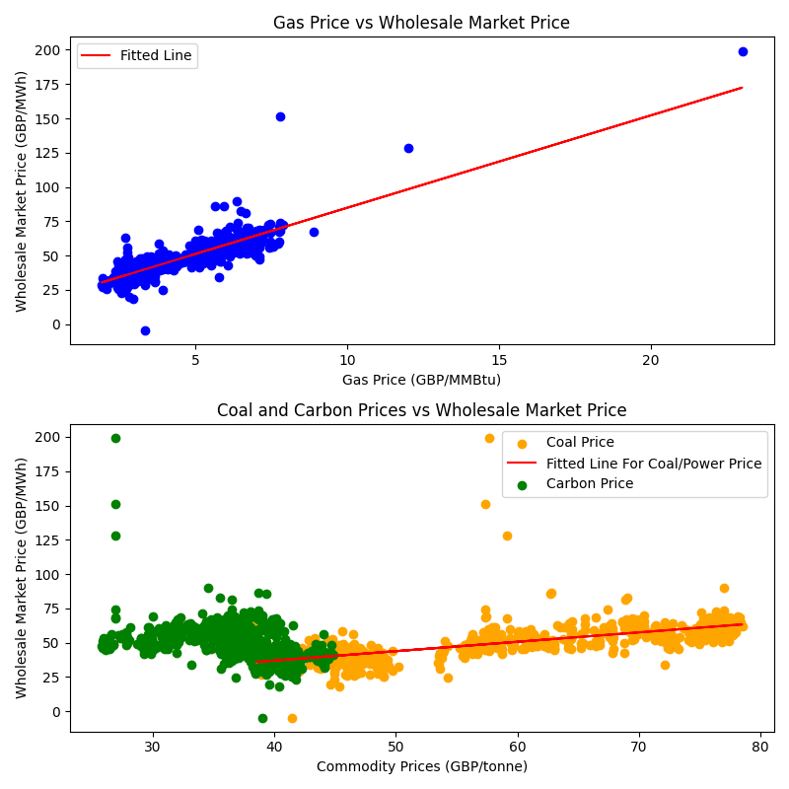
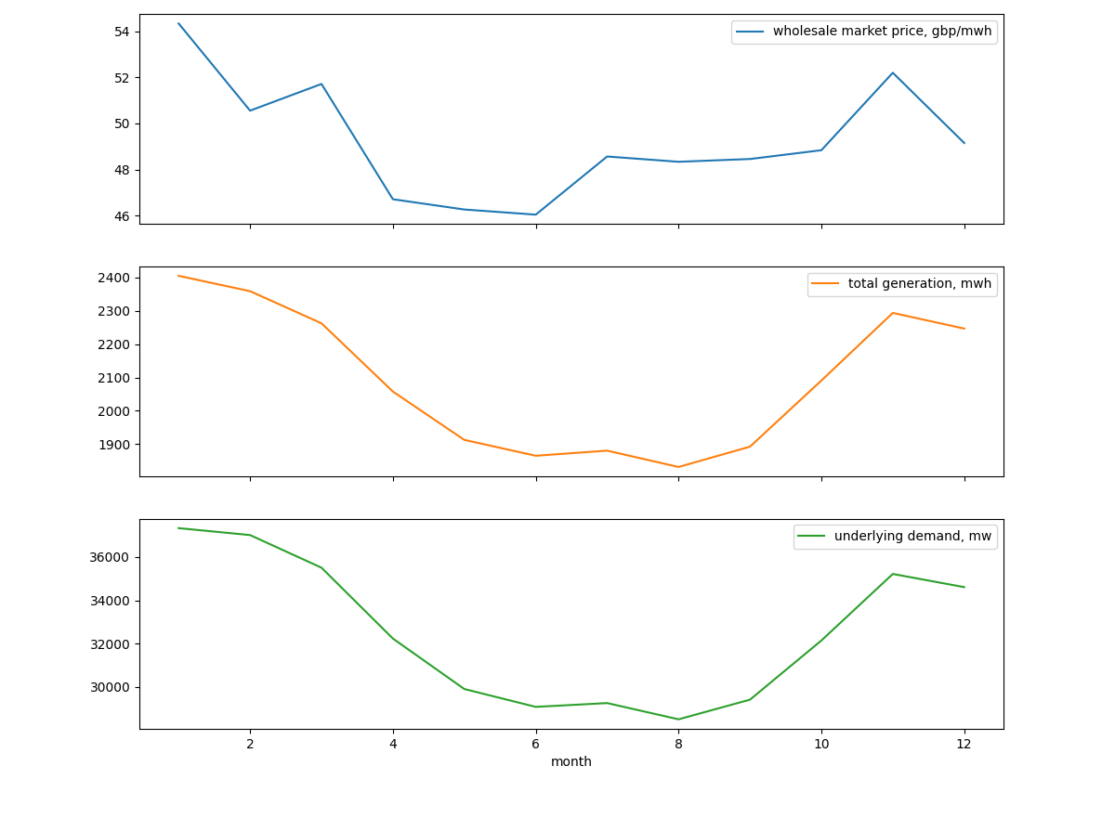
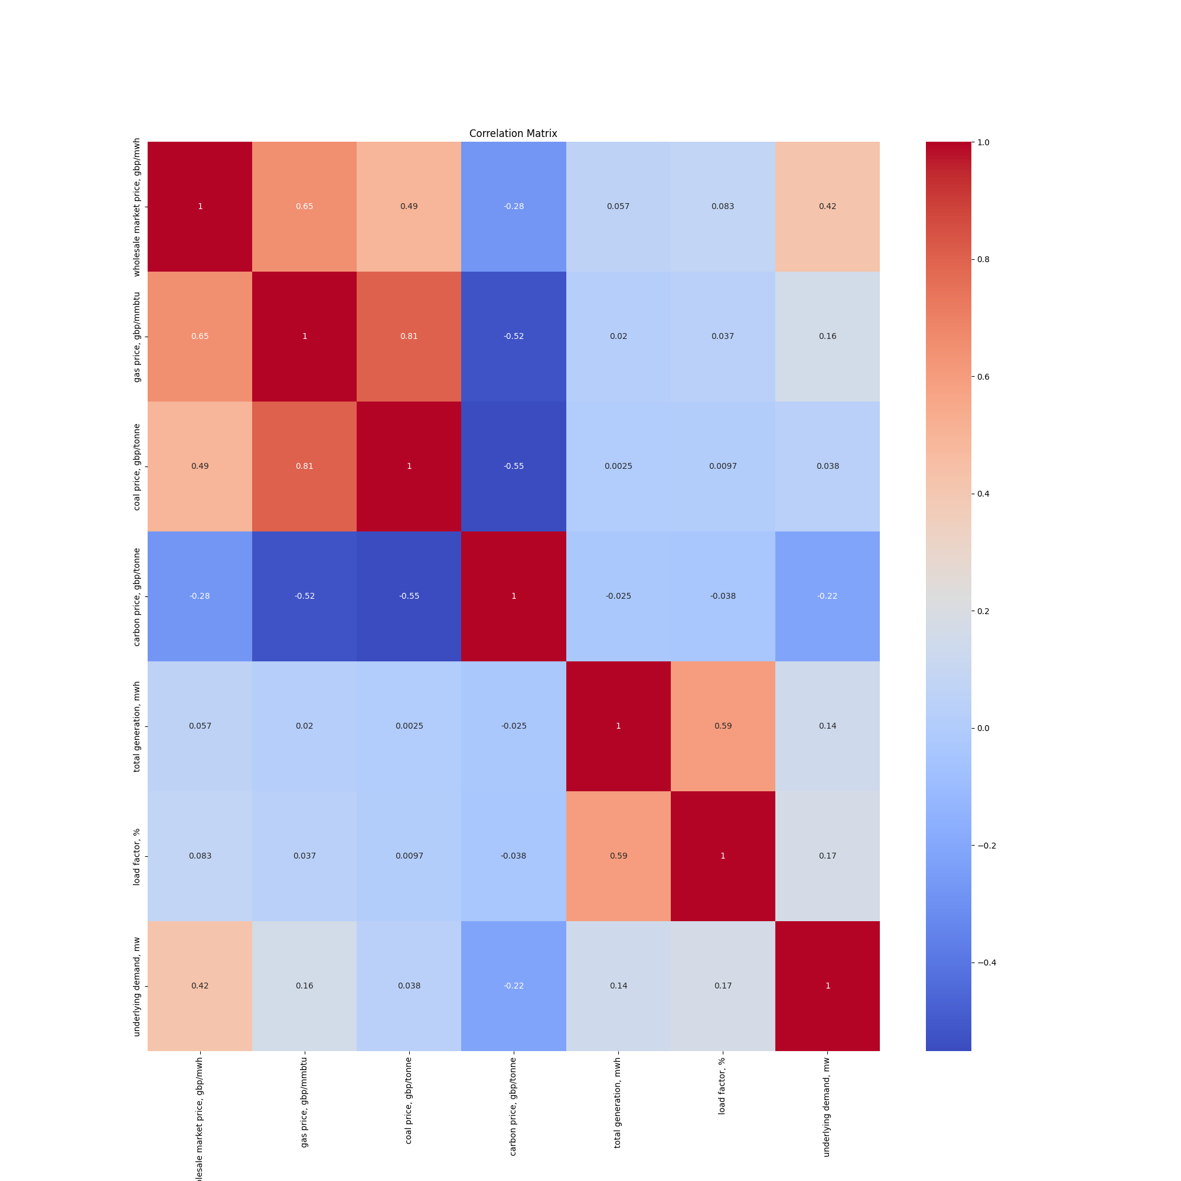
A
Power Price Drivers
Wholesale Market Price is Affected by Commodity Price and Underlying Demand; It Mainly Drives by Gas Price and Has Strong Seasonality
Wholesale Market Price Has Strong Positive Correlations with Gas Price and Coal Price
The Power Prices Shows a Seasonal Pattern, Driven by Heating Demands in Winter
A 1 GBP/MMBtu increase in gas prices results in an approximate 6.74 GBP/MWh increase in wholesale market prices
Strong relationship between gas and power price, with the fitted line explains 73.9% of the power price variability
1 GBP/tonne increase in coal prices results in an approximate 0.68 GBP/MWh increase in power price, moderate correlations
Seasonal Trends in Power Prices and Generation
Winter months experiences higher power prices and underlying demand
Power generation is adjusted based on seasonal demand, with lower generation during summer and increased generation during winter
The demand-driven pricing effect is evident from the correlation between demand and prices
Gas Price
Coal Price
Carbon Price
Tot Generation
Load Factor
Underlying Demand
Correlation of Wholesale Market Price vs
High
Correlations
1.0
Low
Corr
0.0
High
Corr
-0.5
Notes:
Gas Price Model: Coefficient = 6.740653439384791, Intercept = 17.403077283272594, R2 = 0.7391467134056879
Coal Price Model: Coefficient = 0.6846816040723998, Intercept = 9.53554120243394, R2 = 0.41012900059855917

Slide 3
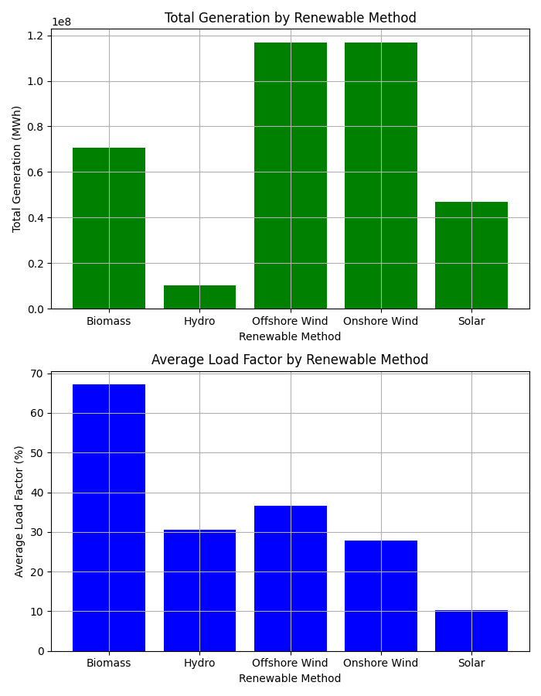
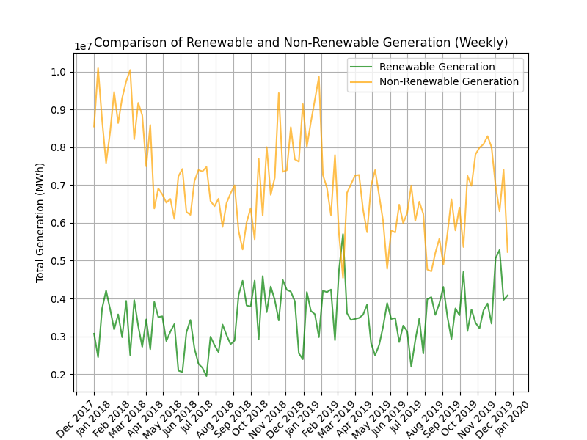
B
Energy Technology Analysis
Renewable Generation is Catching Up Non-Renewable Generation; Wind and Biomass Being the Top Renewable Method With High Generation and Load Factor
The Generation Gap Between Renewable Method and Non-Renewable Method is Decreasing Between 2018-2019
Offshore and Onshore Wind Lead the Renewable Generation; Biomass Has the Highest Load Factor
Renewable energy generation has steadily increased, while non-renewable energy generation shows a declining trend
This trend indicates a significant shift towards renewable energy sources, suggesting increased adoption and investment in renewable technologies
Offshore wind and onshore wind are the leading renewable energy sources in total generation, followed by biomass
Biomass is the highest load factor, indicating its consistent and efficient output

Slide 4
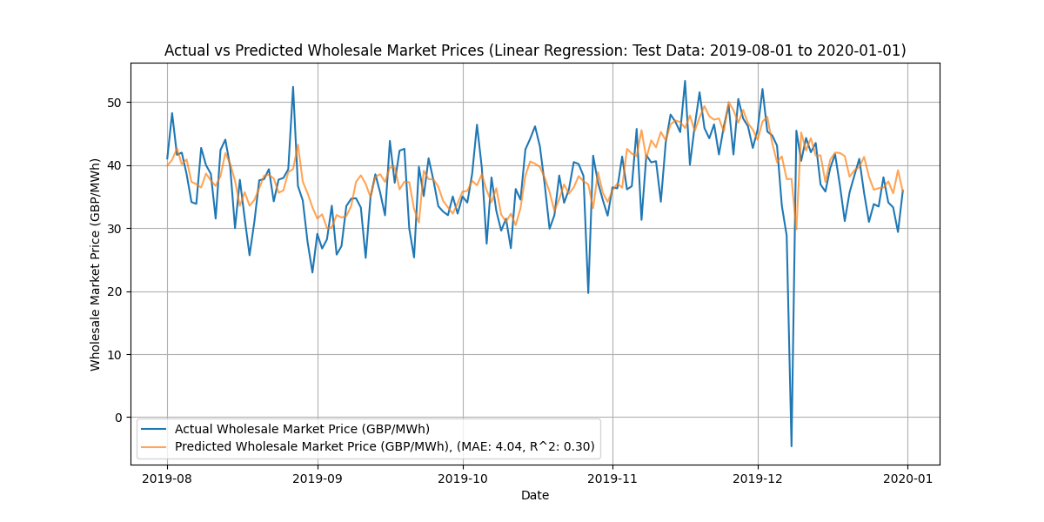
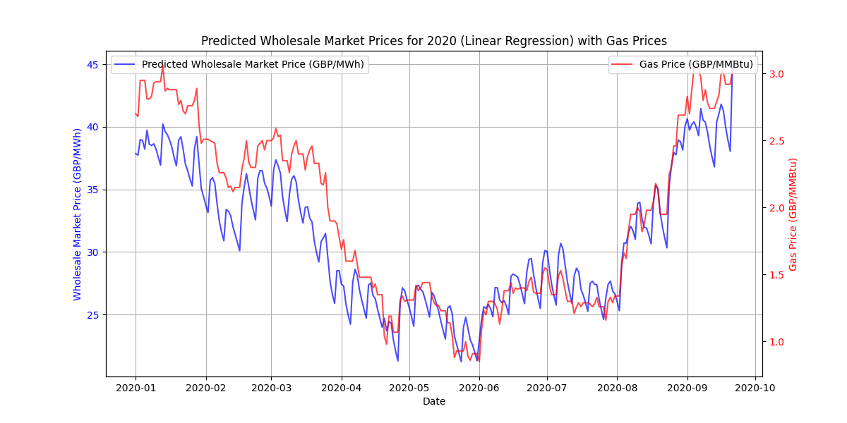
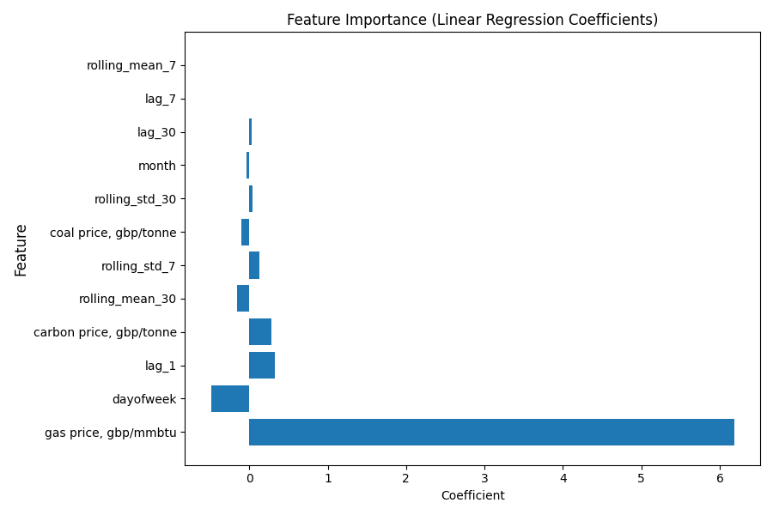
C
Models Predicting Power Price for 2020
Linear Regression Model is Built to predict the Power Price in 2020, With Gas Price Being the Most Important Feature; The Price in 2020 Expect to See a Sharp Drop in the First Half and Gradual Recovery in the Second Half
Linear Regression Model Performs the Best, with Gas Price, Day, and the Price Yesterday Being the Top Features
Predicted Power Price Follow the Gas Price; There is a Sharp Drop in the H1 and Gradually Recover in the H2
Model | Mean Abs Error | R^2 Score
Linear Regression | 4.04 | 0.30
XGBoost | 4.52 | 0.23
Random Forest | 4.51 | 0.25
1
Linear Regression outperforms other models, having mean absolute error of 4.04 and explaining 30.32% of the variability
Gas price is the most important feature, followed by day of the week and power price of yesterday
2
The predicted power price closely followed the gas prices. Significant events like geopolitical tensions and COVID-19 played a crucial role influencing the power prices
1
Oil Price War
2
COVID-19
A price war between Saudi Arabia& Russia led to a significant drop in oil and gas prices
It caused reduction in economic activity and energy demand, resulting drop in gas and power price
* If don’t have historical power prices, model would inference based on previous predicted price
Notes:
Linear:
Mean Absolute Error (Test Data): 4.041928314380013
R^2 Score (Test Data): 0.3031969219833516
Feature Coefficient Absolute Coefficient
0 gas price, gbp/mmbtu 6.181389 6.181389
3 dayofweek -0.486447 0.486447
5 lag_1 0.325537 0.325537
2 carbon price, gbp/tonne 0.284354 0.284354
10 rolling_mean_30 -0.154826 0.154826
9 rolling_std_7 0.124080 0.124080
1 coal price, gbp/tonne -0.103034 0.103034
11 rolling_std_30 0.041461 0.041461
4 month -0.036668 0.036668
7 lag_30 0.025549 0.025549
6 lag_7 -0.005218 0.005218
8 rolling_mean_7 -0.000848 0.000848
XGBoost
Mean Absolute Error (Test Data): 4.524378116416113
R^2 Score (Test Data): 0.22553011035945736
Random Forest
Mean Absolute Error (Test Data): 4.509940583734696
R^2 Score (Test Data): 0.2522506401804463

Slide 5
D
Appendix
Data Exploration: Correlation Matrix for Slide 1

Slide 6
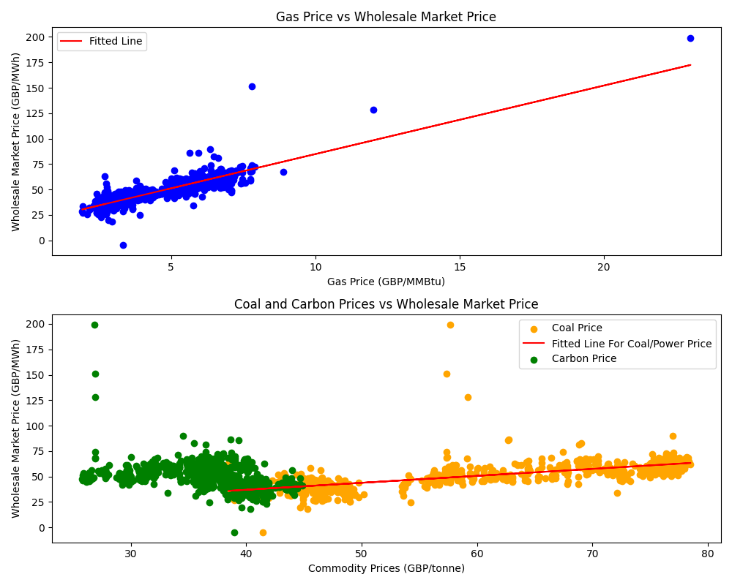
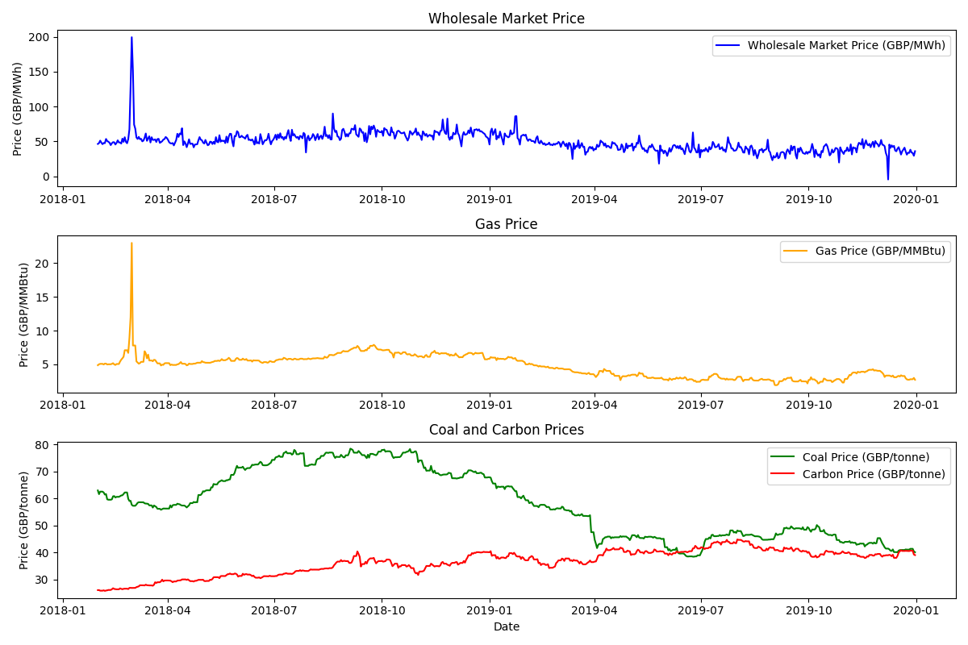
D
Appendix
Slide 1: Wholesale Power Price vs Commodity Price

Slide 7
D
Appendix
Slide 1: Wholesale Power Price vs Total Generation and Underlying Demand

Slide 8
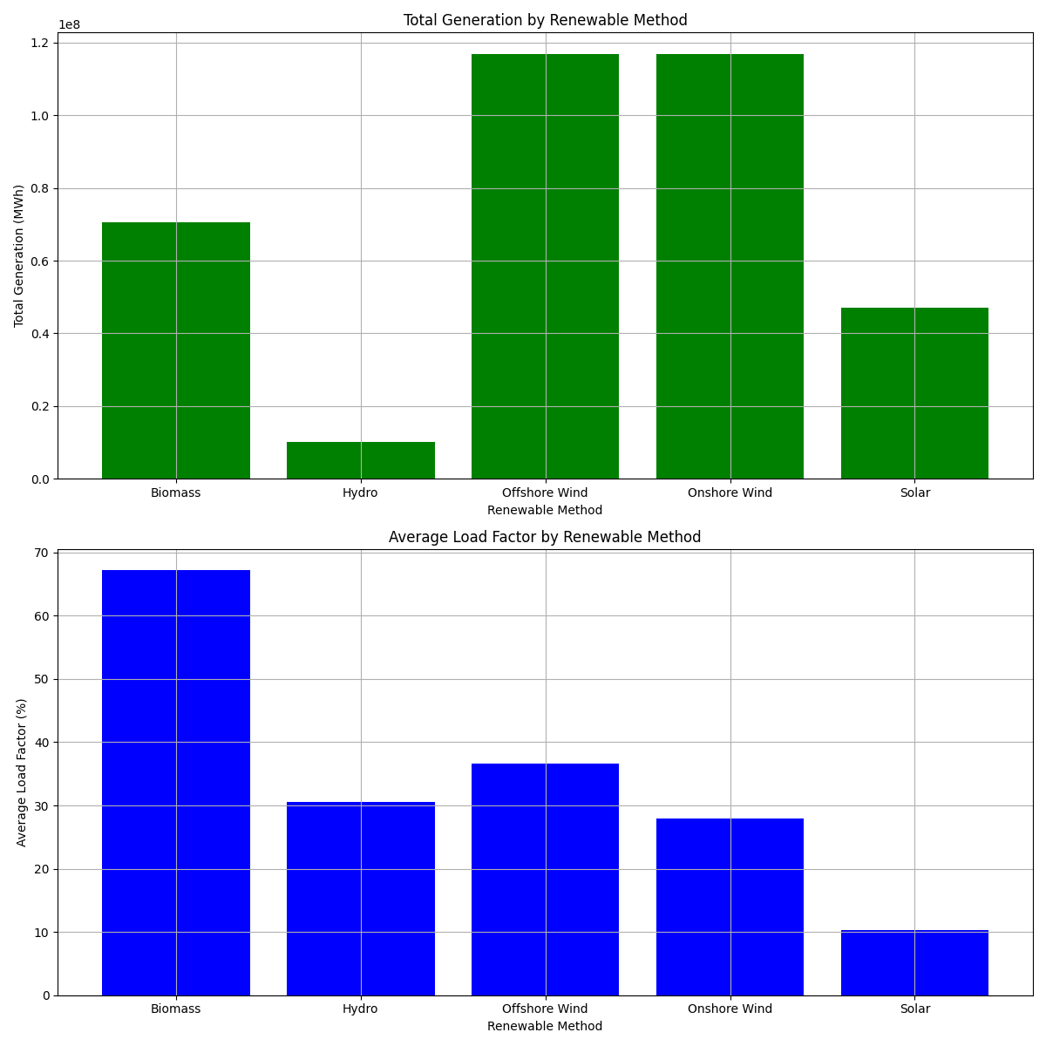
D
Appendix
Slide 2: Total Generation and Average Load Factor by Renewable Method

Slide 9
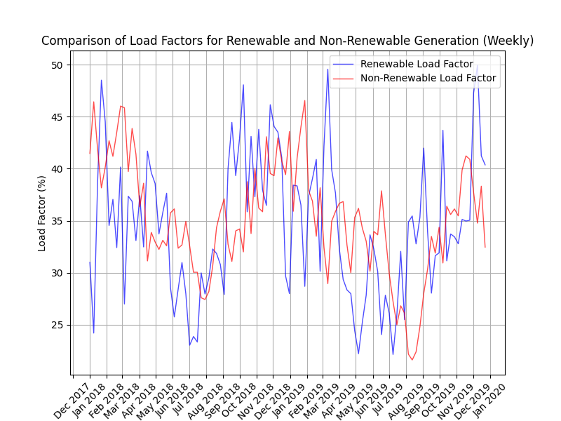
D
Appendix
Slide 2: Renewable and Non-Renewable Generation and Load Factor Comparison

Slide 10
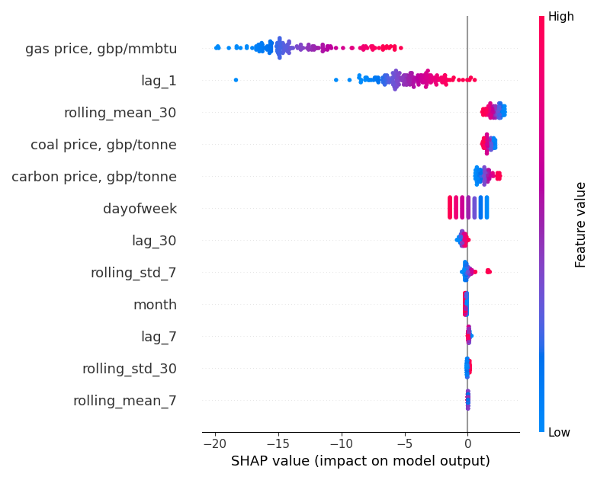
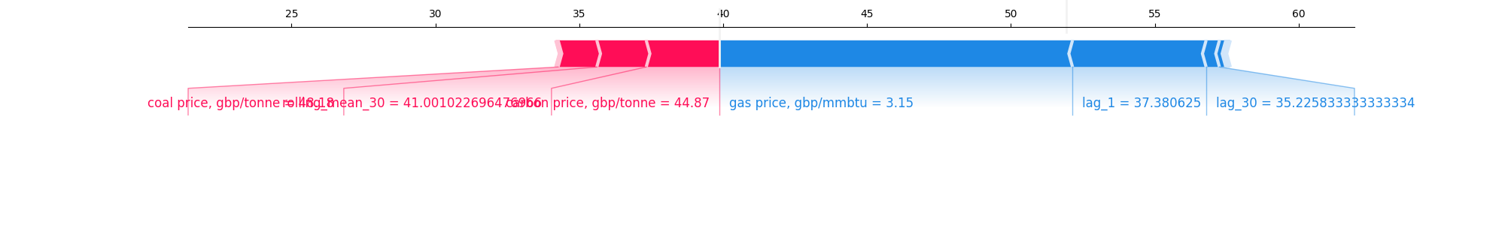
D
Appendix
Slide 3: Linear Regression Model Test Result and Feature Explanation

Slide 11
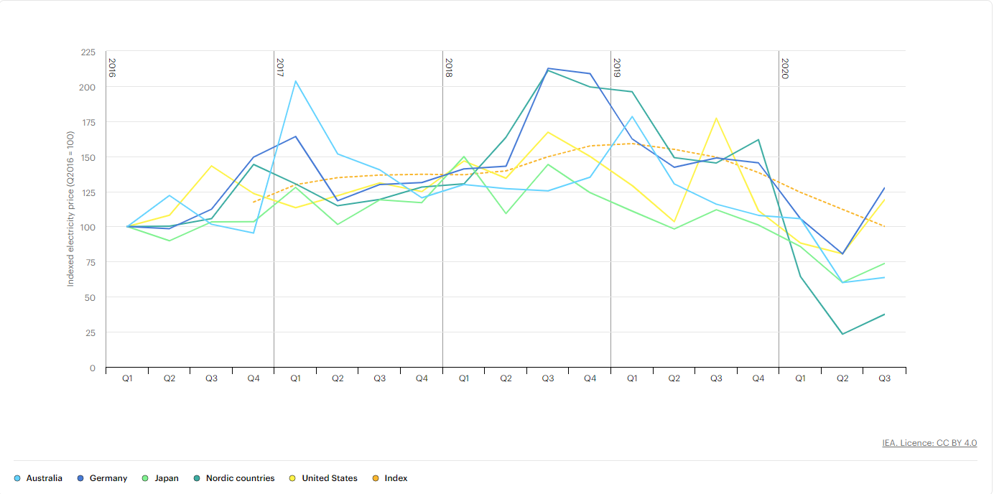
D
Appendix
Slide 3: Linear Regression Model Power Price Inference and Actual Price Globally
Quarterly average electricity prices in selected markets, 2016-2020
Notes:
Quarterly average electricity prices in selected markets, 2016-2020 – Charts – Data & Statistics - IEA

Slide 12
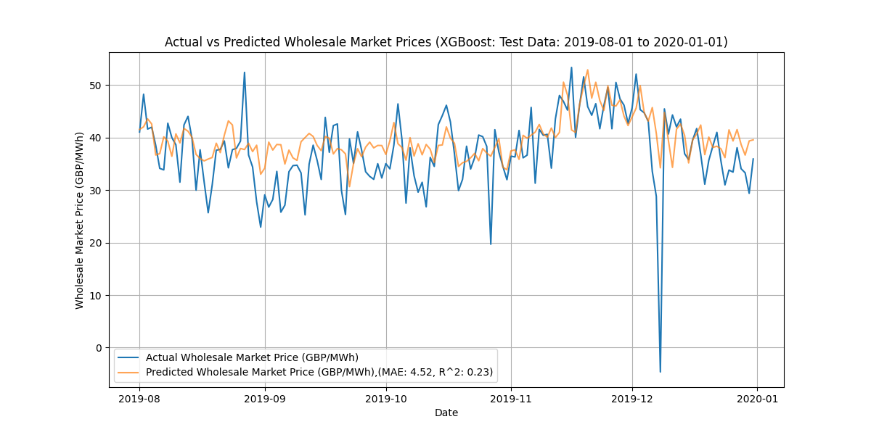
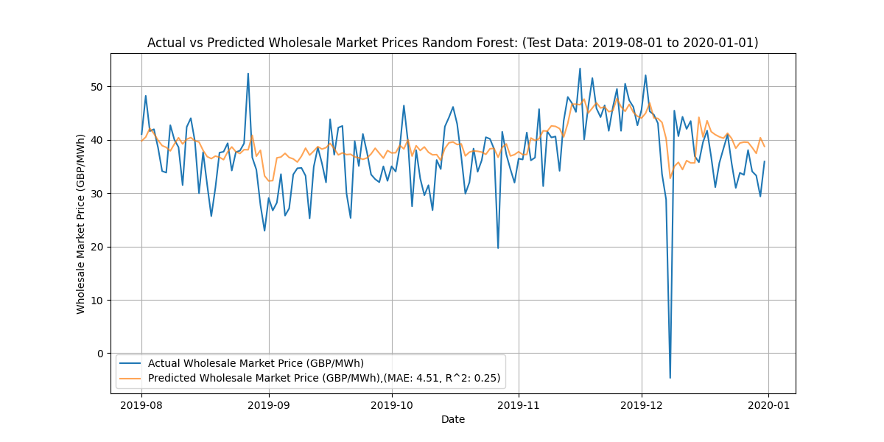
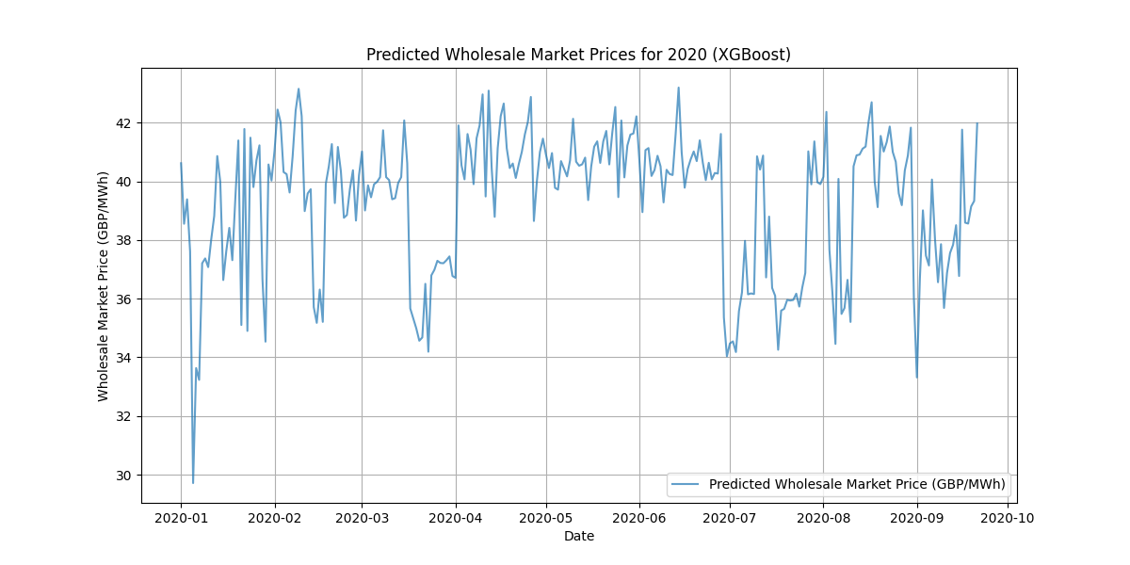
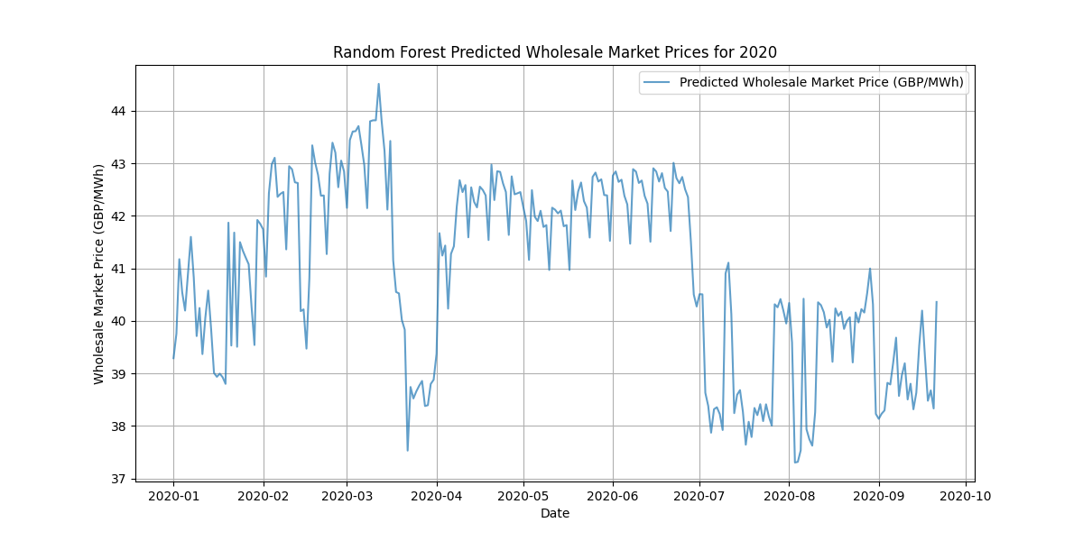
D
Appendix
Slide 3: Other Models Test and Inference Result

Slide 13
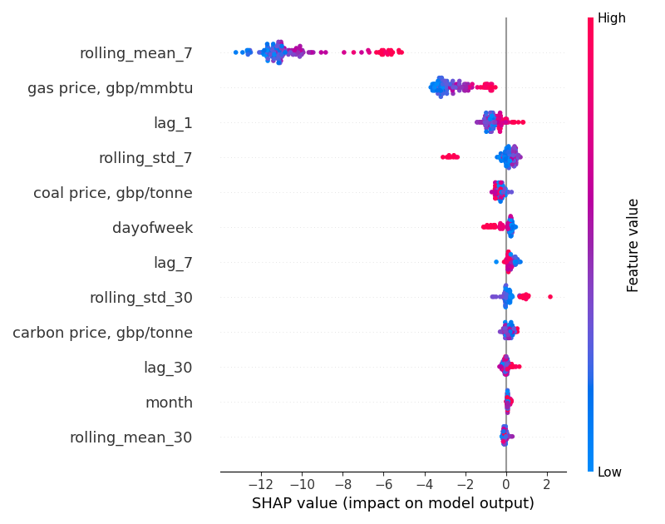
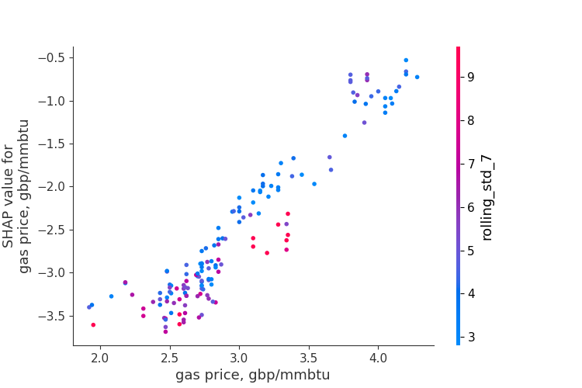
D
Appendix
Slide 3: Random Forest Feature Explanation

